Slide 1
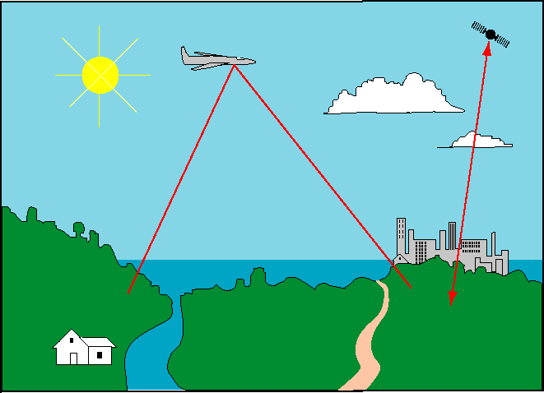
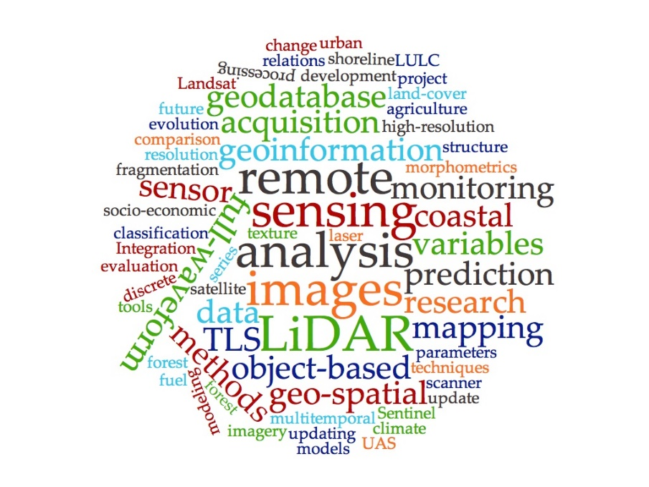
Artak Piloyan
Yerevan, RA
2022
Satellite Image Processing

Slide 2
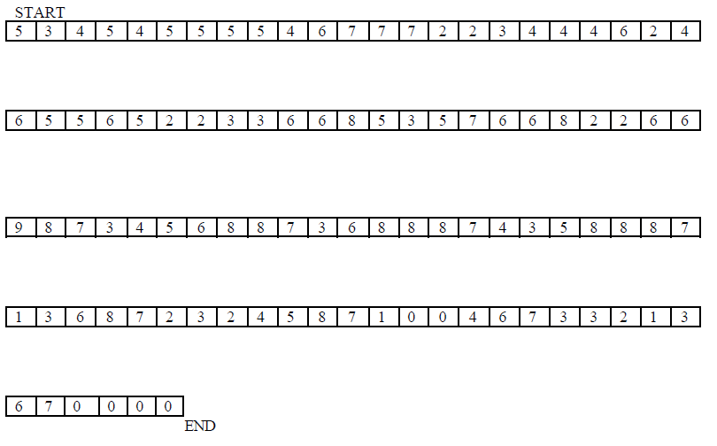
Digitised Image, 2 Bands, 7*7 Pixel

Slide 3
1A
1B
1C
1A
1B
1C
1A
1B
1C
2A
2B
2C
2A
2B
2C
2A
2B
2C
Header
1A
1A
1A
1B
1B
1B
1C
1C
1C
2A
2A
2A
2B
2B
2B
2C
2C
2C
eof
Header
1A
1B
1C
1A
1B
1C
1A
1B
1C
2A
2B
2C
2A
2B
2C
2A
2B
2C
eof
Header
1A
1B
1C
2A
2B
2C
1A
1B
1C
2A
2B
2C
2A
2B
2C
2A
2B
2C
eof

Slide 4
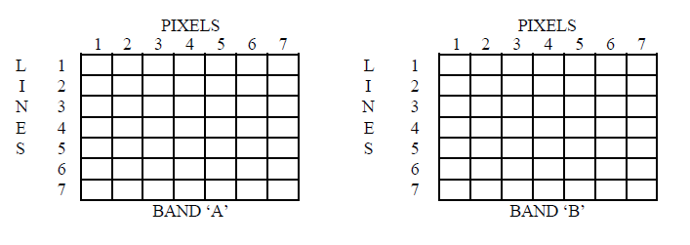
Task 1 and 2

Slide 5
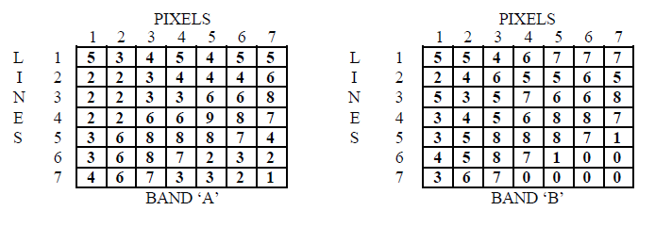
Result Task 1 and 2

Slide 6
Grey Values

Slide 7
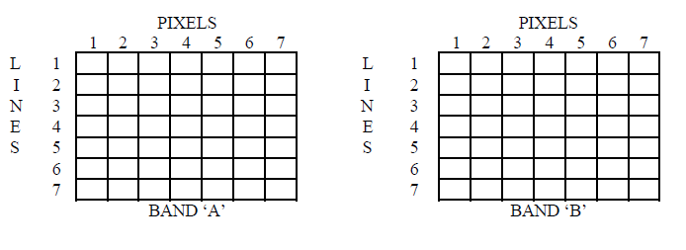
Task 3: Visualisation / Representation of digital values in grey values

Slide 8
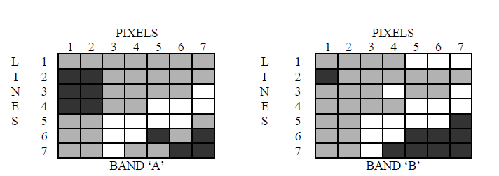
Result Task 3

Slide 9
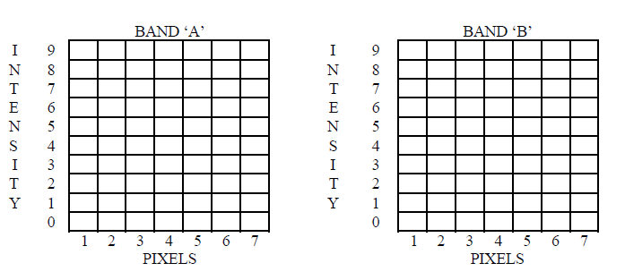
Task 4: Intensity profiles line 6

Slide 10
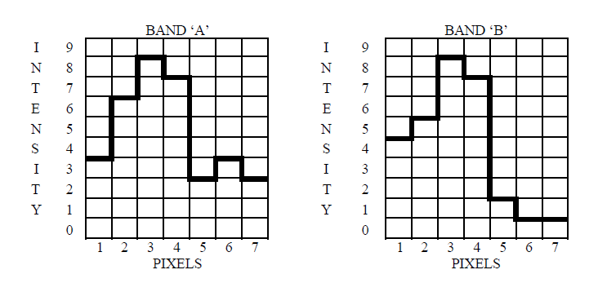
Result Task 4:

Slide 11
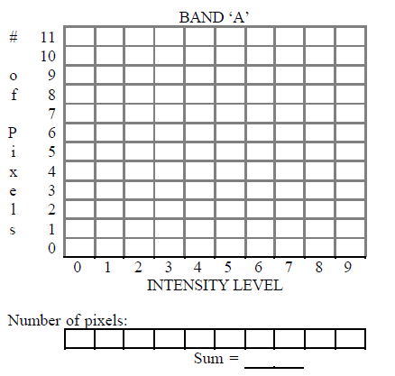
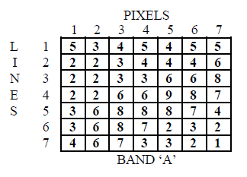
Task 5: Histogram

Slide 12
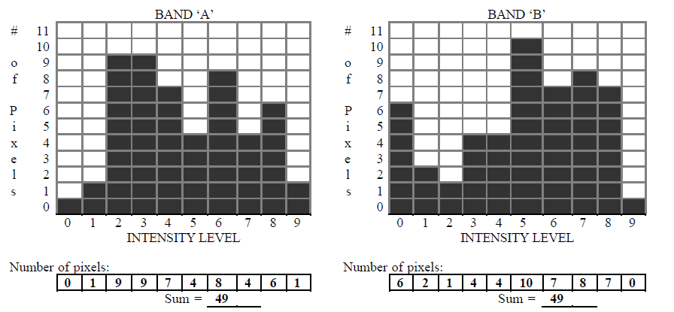
Result Task 5 for 2 Bands

